Slide 1
Production Functions
Meaning, Types of production functions

Slide 2
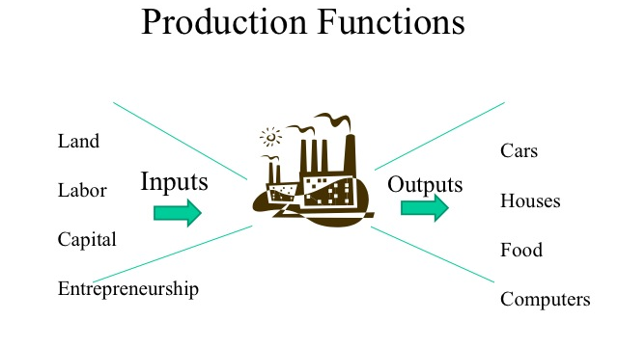

Slide 3
Production function – What is it?
The term “Production function” refers to the relationship between the inputs and the outputs produced by them.
The relationship is purely physical or technological in character, that is, it ignores the prices of inputs and outputs.
The study of production function is directed towards establishing the maximum output which can be achieved with a given set of resources or inputs and with a given state of technology.

Slide 4
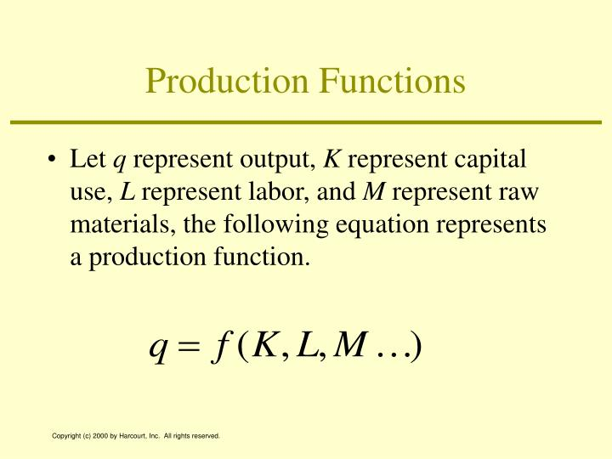

Slide 5
Types of Production functions
In economic theory we are concerned with three types of production functions:
1. Production function with one variable input
2. Production function with two variable inputs, and
3. Production function with all variable inputs.

Slide 6
Production function with one variable input
Other Names: 1. Law of Variable Proportions
2. Law of Diminishing Marginal Returns/Productivity
Law of Variable proportion shows the input-output relationship with one factor variable, while other factors of production are kept constant
Suppose a farmer has 20 acres of land to cultivate. The land has some fixed investment i.e., capital on it; a tube well, farm machinery. The amount of land and capital is supposed as fixed factor. The farmer can vary the number of labourers to be employed on cultivation. Thus labor is the variable factor.
The change in labourers will change the output.

Slide 7
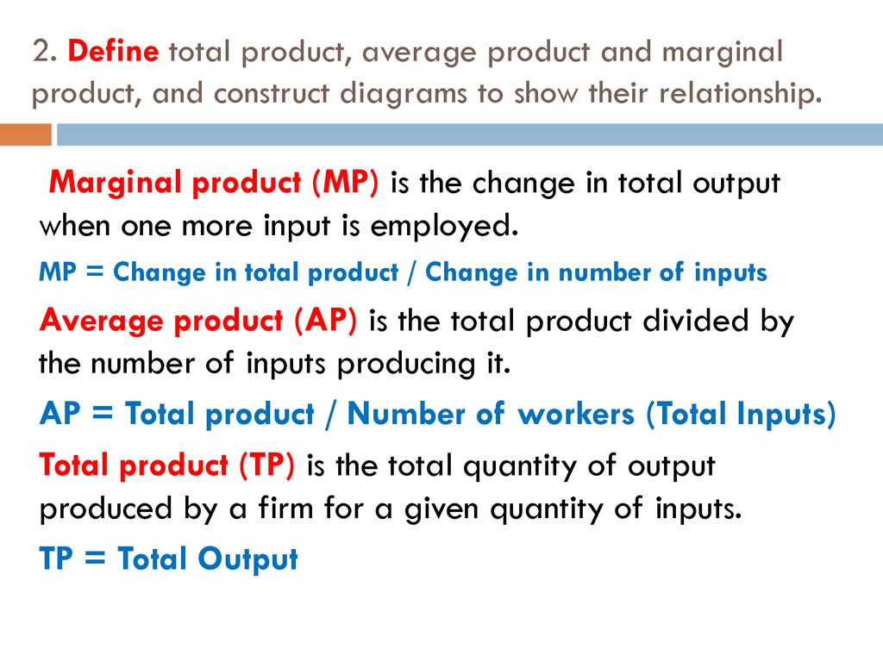

Slide 8
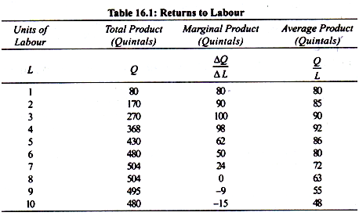

Slide 9
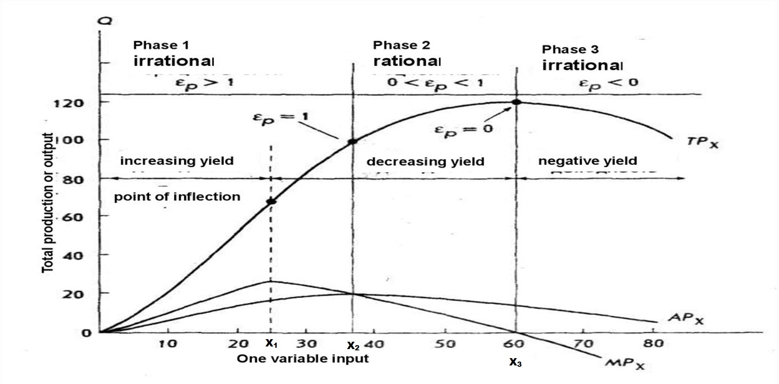

Slide 10
Three Stages of Production
The total, average and marginal product curves demonstrate the law of variable proportions.
The total product curve is divided into three segments popularly known as three stages of production.
Stage I
Stage I is the segment from the origin to X₂
At this point(X₂), the marginal product of x equals its average product
X₂ is also the point at which the average product is maximized
The production is characterized first by increasing marginal returns to the variable factor from the origin to point X₁ and then diminishing marginal returns, from X₁ to X₂.

Slide 11
Stage II
The second stage lies in the range from X₂ to X₃. Stage II begins where the average product of the variable factor is maximized and continues to the point at which total product is maximized and marginal product is zero.
This stage is characterized by diminishing returns to the variable input over its entire range.
Although total product is increasing in this range, it does so at a continuously decreasing rate.

Slide 12
Stage III
Stage III, the area beyond X₃, where the total product curve starts decreasing. In this range, the marginal product of the variable factor is negative.
Stage II is Rational
Only stage II is rational which means relevant range for a firm to operate.

Slide 13
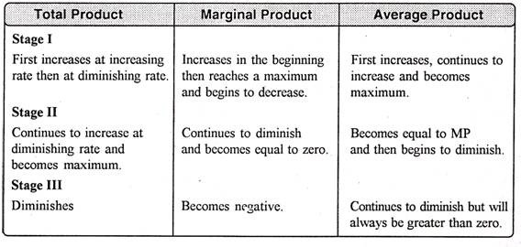
Behavior of TP, MP and AP during three stages of production

Slide 14
Assumptions
1. Constant Technology: if technology changes, MP and AP may rise instead of diminishing.
2. Short Run: The law operates in the short run because it is here that some factors are fixed and other are variable. In the long run, all factors are variable.
3. Homogenous Input: The variable input as applied unit by unit is homogeneous or identical in amount and quantity.
4. It is possible to use various amounts of a variable factor on the fixed factors of production.

Slide 15
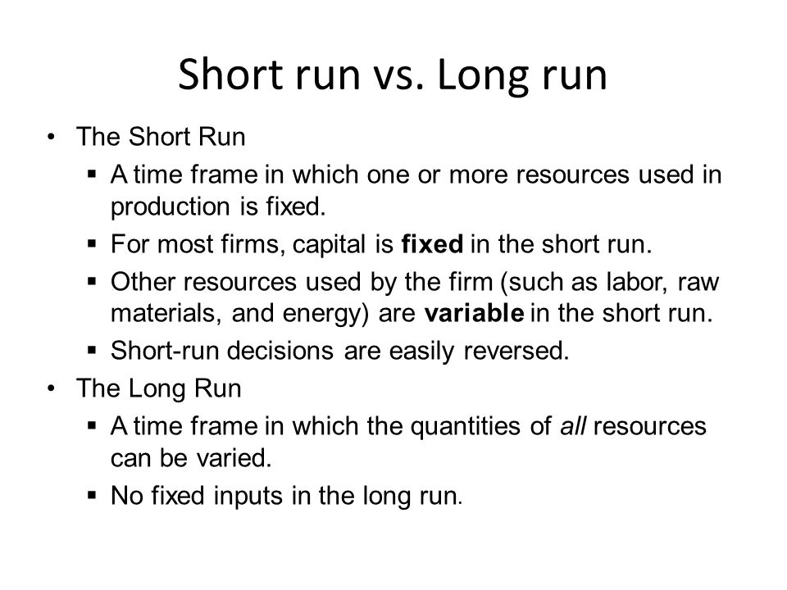

Slide 16
Production Function with Two Variable Inputs
Isoquants:
To understand a production function with two variable inputs, it is necessary to know what an isoquant is.
Other Names: Iso-product curve, Equal-Product curve or a Production indifference curve.
These curves show the various combinations of two variable inputs resulting in the same level of output.

Slide 17
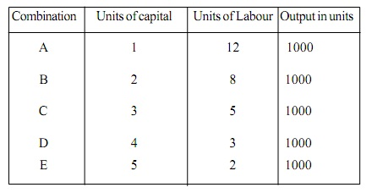
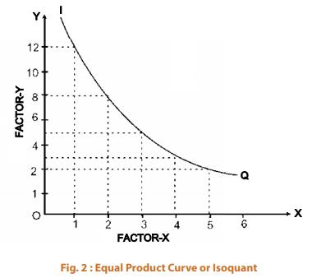
Labor & Capital Inputs in relation to Output
It will be seen that output is the same either by employing 12L+1C or by 5L+3C or by 2L+5C ( and so on).
This relationship, when shown graphically, results in an isoquant.

Slide 18
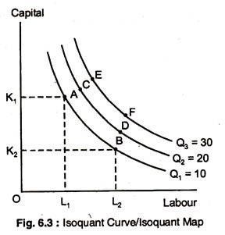
Isoquant & Isoquant Map
An Isoquant is defined as the curve passing through the plotted points representing all the combinations of the two factors of production which will produce a given output.
Figure besides gives a typical Isoquant diagram whereas one moves upward to the right, higher levels of outputs are obtained, using larger quantities of inputs.
For each level of output there will be a different Isoquant.
When whole array of isoquants are shown on graph, it is called an Isoquant Map.

Slide 19
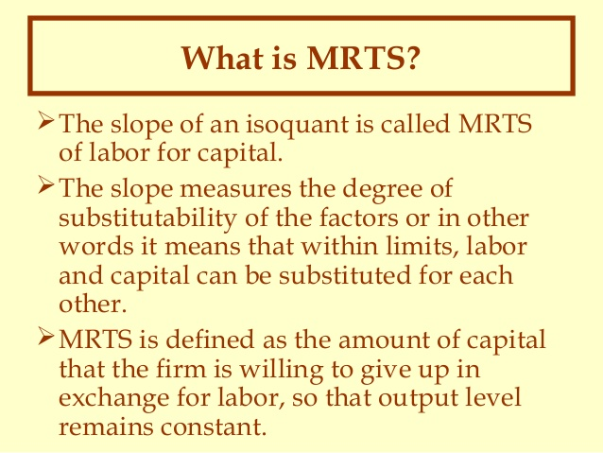
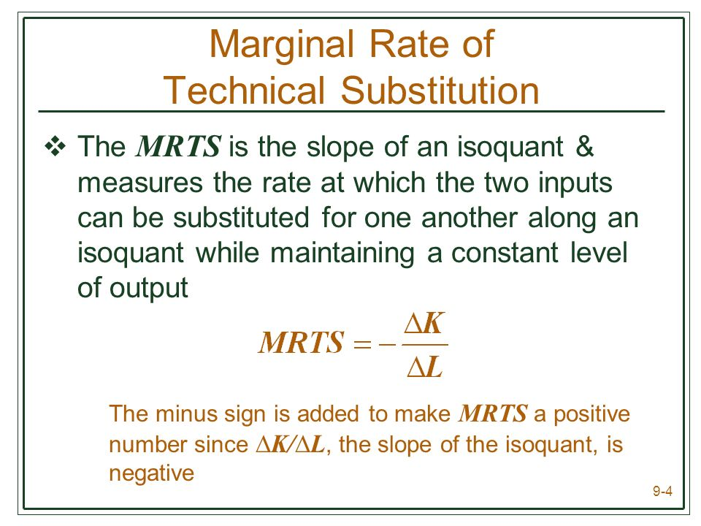
Substitutability of Inputs Assumption in Isoquant Diagram is that the inputs can be substituted for each other.

Slide 20
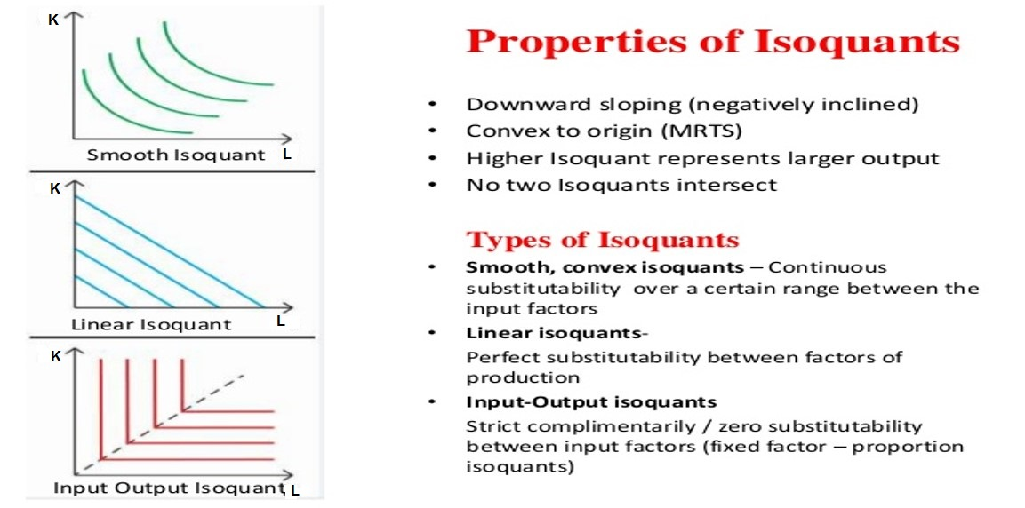

Slide 21
Optimal Input Combinations
So far, we have discussed the production function which has purely physical or technological character,
However, it does not tell which input combinations are optimal; for that purpose, One must consider the input prices.
Iso-cost curve shows the quantities of Labor and Capital that can be purchased for Rs.5 lakh, another Isocost curve showing the quantities which can be purchased for Rs.6 lakh and so on.

Slide 22
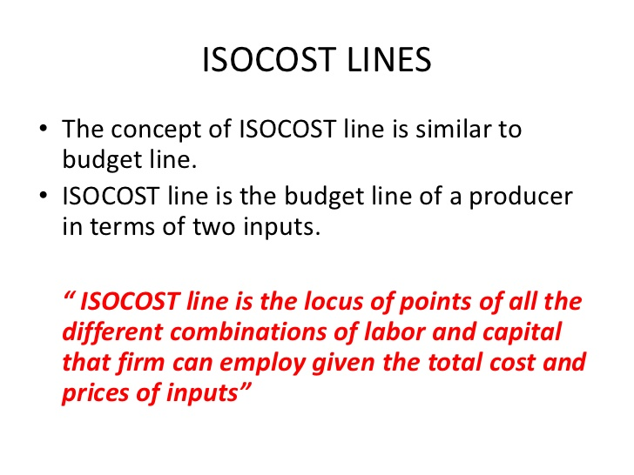
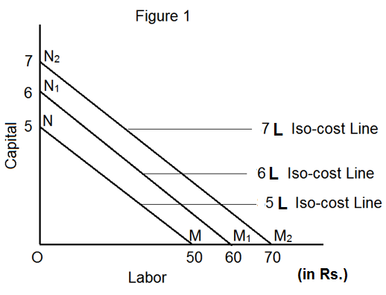
Isocost Curves

Slide 23
Least-Cost Combination of Inputs – How to Obtain?
Now, we can easily superimpose the isocost diagram on the isoquant diagram (as the axes in both the cases represent represent the same variables). With the help of the figure, one can ascertain the maximum output for a given outlay. This maximum output which is possible with a given outlay, is represented by the isoquant tangency to the isocost curve.

Slide 24
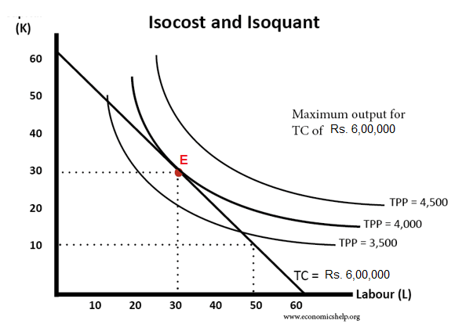

Slide 25
Least-Cost Combination of Inputs
The optimum combination of inputs is represented by Point E, the point of tangency.
At this point, the Marginal Rate of Substitution (MRS/MRTS) between the inputs is equal to the ratio between the prices of the inputs.
In order to minimize the costs for a given output, one has to refer the Isoquant and Isocost curves. It should be clear that, minimum cost for the output is represented by Isocost line tangency to Isoquant.

Slide 26
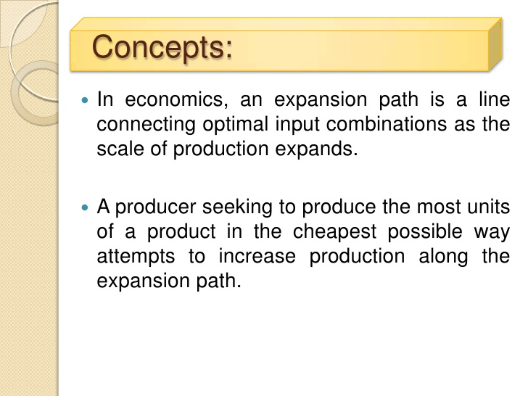
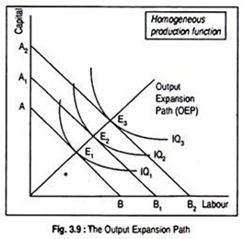
Expansion Path

Slide 27



Slide 28



Slide 29
Production Function with all variable inputs – Returns to Scale
A situation where all inputs are subject to variation is a case of long-run production function.
In the short run, fixed inputs set an upper limit to the output because, additional units of variable factors are not accompanied by a corresponding change in the fixed factors of production. Consequently, contribution of variable inputs declines.
By definition, in the long run such limitations do not exist. In the long run all inputs can change. Let us consider two inputs, labour(L) and Capital(K), These can change in two ways:
1. both L and K change in the same proportion, implying that (K/L) ratio or technique of production remains the same, or
2. L and K change in different proportion, implying the (K/L) ratio or technique of production varies with change in output

Slide 30
The percentage increase in output when all inputs vary in the same proportion is known as “Returns to Scale”. Obviously, returns to scale relate to greater use of inputs maintaining the same technique of production. Where returns to scale occurs, three alternative situations are possible:
1. Increasing Returns to Scale: Output increases by a greater proportion than the
increase in inputs.
2. Constant Returns to Scale: Output increases in the same proportion as the increase
in inputs.
3. Decreasing Returns to Scale: Output increases by a lesser proportion than the
increase in inputs.

Slide 31
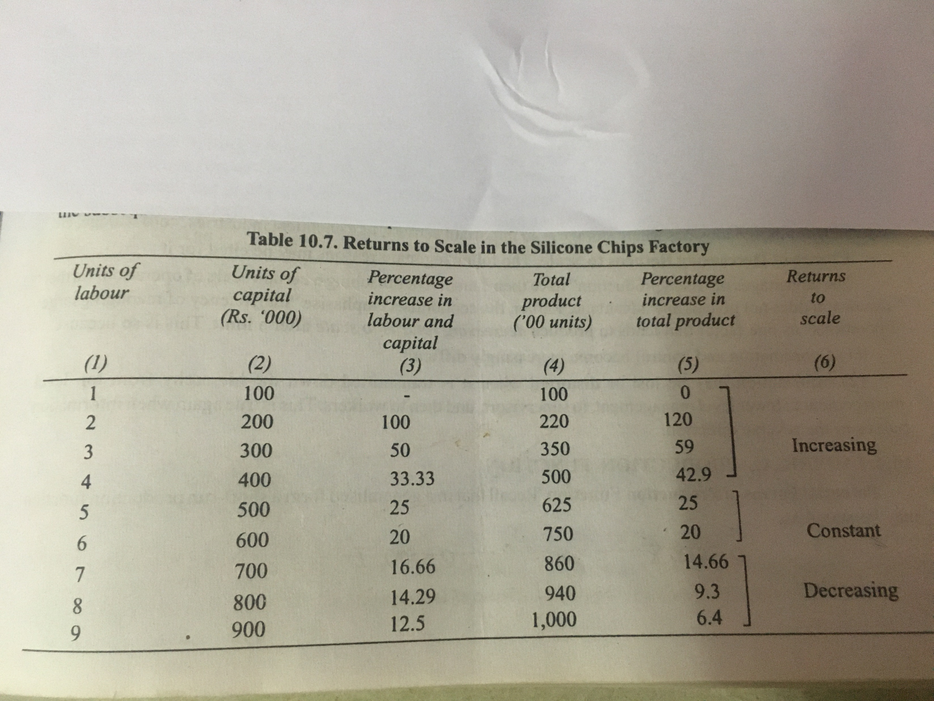

Slide 32
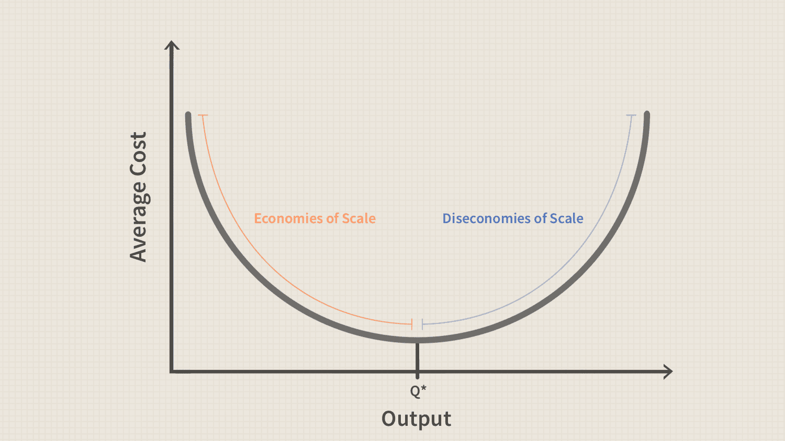

Slide 33
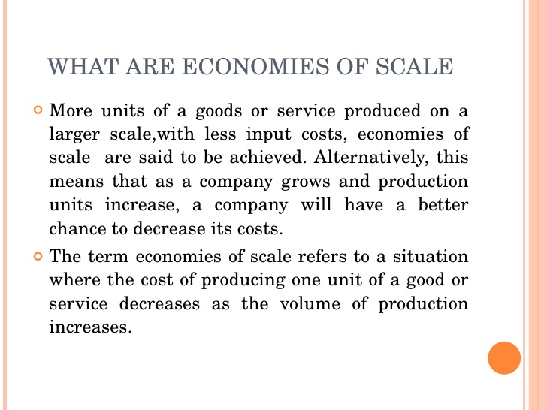

Slide 34
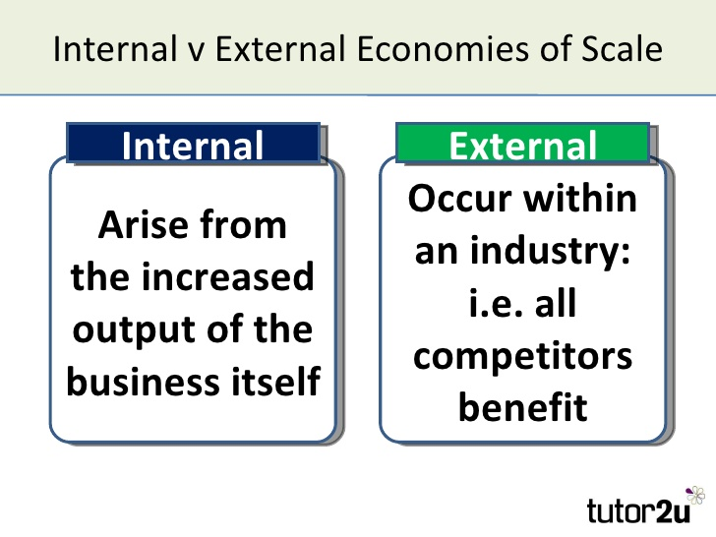

Slide 35
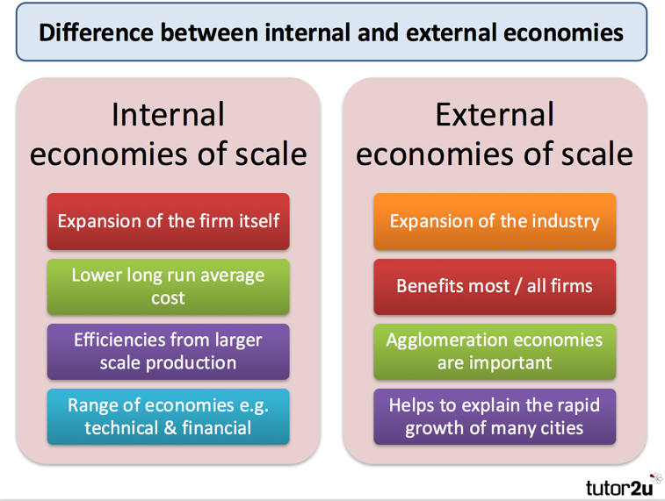

Slide 36
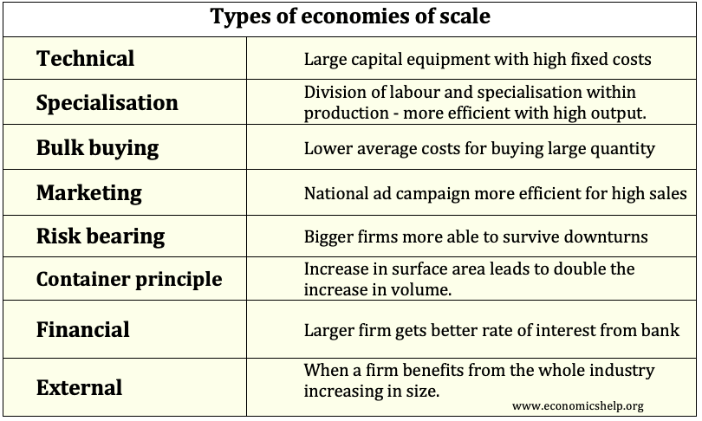

Slide 37
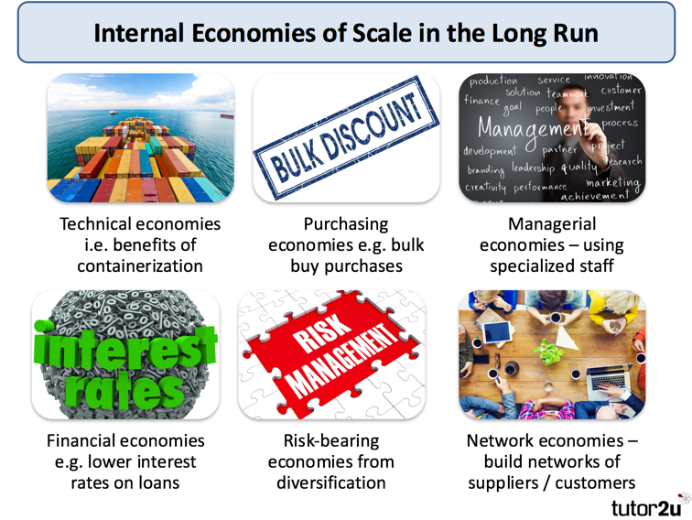

Slide 38
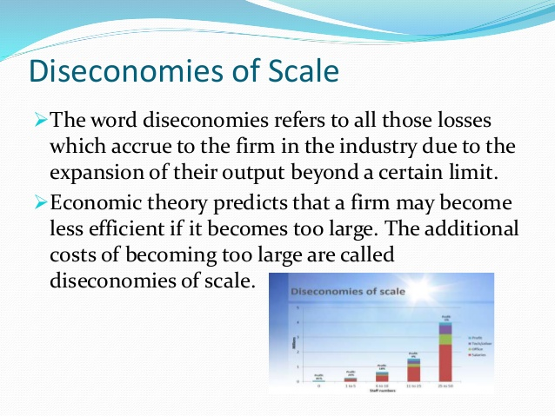

Slide 39


Slide 40


Slide 41


Slide 42
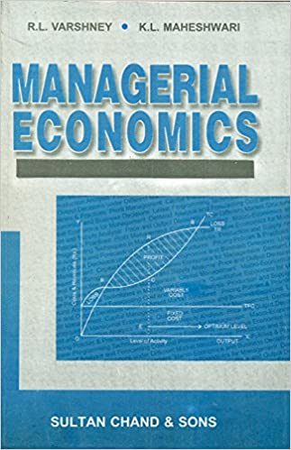
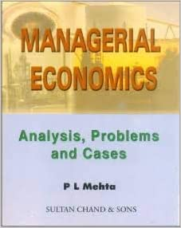
References

